Slide 1
Belief Networks (BRML ch. 3)
Ishii Lab., Systems Science Department, Graduate School of Informatics, Uji Campus, Kyoto University
Sequential Data Analysis Study Group
By: Kourosh Meshgi
To: SDA Study Group, Dr. Shigeyuki Oba
On: 2011-11-11

Slide 2
Contents
The Benefits of Structure
Uncertain and Unreliable Evidence
Belief Networks
Causality
Summary
Structure
Evidence
Belief Networks
Causality
Summary

Slide 3
Importance
Independently specifying all the entries of a table needs exponential space
Computational tractability of inferring quantities of interest
Idea:
to constrain the nature of the variable interactions
to specify which variables are independent of others→leading to a structured factorisation of the joint probability distribution
Structure
Evidence
Belief Networks
Causality
Summary

Slide 4
Belief Networks
Also: Bayes' networks, Bayesian belief networks
A way to depict the independence assumptions made in a distribution
Application examples
Troubleshooting
Expert reasoning under uncertainty
Machine learning
Structure
Evidence
Belief Networks
Causality
Summary

Slide 5
Approach: Modeling
Read the problem
Make a model of the world
Variables (binary)
Probability distribution on the joint set of the variables of interest
Decomposition: Repeatedly using the definition of conditional probability
Lots of states (2 ^ # of variables) to be specified!
Structure
Evidence
Belief Networks
Causality
Summary

Slide 6
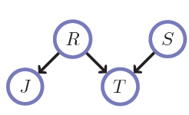
Independence Assumptions
Assume the A is not directly influenced by B
p(A|B) = p(A)
p(A|B,C) = p(A|C), …
Represent these conditional independencies graphically
What caused what?
e.g. R caused T
Reduces the number of values that we need to specify
Structure
Evidence
Belief Networks
Causality
Summary

Slide 7
Approach: Modeling (continue)
Read the problem
Make a model of the world
Decomposition
Conditional Independency Graph
Simplification: Simplify conditional probability terms of independent events
Structure
Evidence
Belief Networks
Causality
Summary

Slide 8
Inference
Bayes Rule
p(A|B) = p(A,B) / p(B)
p(A happens given that B happened): Posterior
B: Evidence
p(B): Prior knowledge about B
Calculate the probability model of the world
General purpose algorithms for this calculations
Junction Tree Algorithm
Structure
Evidence
Belief Networks
Causality
Summary

Slide 9
Explain Away
When additional evidence come to the calculation and cause the initial probability to drop dramatically, it is told that it explains away the first probability.
e.g. Alarm → p( Burglar|A) = 0.99
Radio → p( Burglar| A , R ) = 0.01
Knowing R drops p(B|<Evidence>)
It explains away the chance of Burlgary
Structure
Evidence
Belief Networks
Causality
Summary

Slide 10
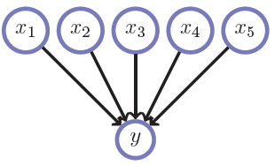
Reducing the burden of specification
Too much parents for each node?
Exponential # of rows in specification table
e.g. 32 rows for 5 binary parents
Solutions:
Constrain the table to have a simpler parametric form (e.g. Divorcing Parents)
Using simple classes of conditional tables (e.g. Noisy Logic gates)
Structure
Evidence
Belief Networks
Causality
Summary

Slide 11
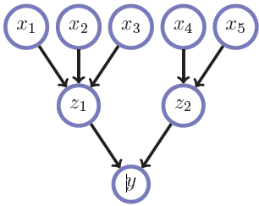
Divorcing Parents
Constrain the table to have a simpler parametric form
Decomposition in which only a limited number of parental interactions are required
e.g. 16 (8 + 4 + 4) rows for 5 binary parents
Structure
Evidence
Belief Networks
Causality
Summary

Slide 12
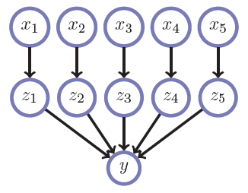
Noisy Logic Gates
Using simple classes of conditional tables
The number of parameters required to specify the noisy gate is linear in the number of parents
Noisy-OR: at least one of the parents is present, the probability that the node will be present is high
e.g. 10 (=2+2+2+2+2) rows
for 5 binary parents
disease-symptom networks
Structure
Evidence
Belief Networks
Causality
Summary

Slide 13
Uncertain (Soft) Evidence
The evidence variable is in more than one state, with the strength of our belief about each state being given by probabilities
In contrast, for hard evidence we are certain that a variable is in a particular state
e.g. p(A) → p(A | Ã)
Inference → using Bayes' rule
Jeffrey’s Rule: first define the model conditioned on the evidence, and then average over the distribution of the evidence
a generalization of hard-evidence
Structure
Evidence
Belief Networks
Causality
Summary

Slide 14
Unreliable (Likelihood) Evidence
The evidence can’t be trusted 100%.
Virtual Evidence: own interpretation of the evidence.
e.g. p(A|B) → p(H | B)
Structure
Evidence
Belief Networks
Causality
Summary

Slide 15
Approach: Modeling
Read the problem
Make a model of the world
Decomposition
Conditional Independency Graph
Simplification
Substitute Unreliable Evidence with Virtual Ones
Jeffrey’s Rule
Adding Uncertain Evidence
Structure
Evidence
Belief Networks
Causality
Summary

Slide 16
Belief Networks Definition
A distribution of the form
Representation
Structure: Directed Acyclic Graph (DAG)
Arrows: Pointing from parent variable to child variable
Nodes: p(x_{i} | pa(x_{i}))
Structure
Evidence
Belief Networks
Causality
Summary

Slide 17
Construction of BN on variables
Write down the n-node cascade graph
Label the nodes with the variables in any order
Each successive independence statement corresponds to deleting one of the edges.
Result: DAG
Structure
Evidence
Belief Networks
Causality
Summary

Slide 18
Notes
Every probability distribution can be written as a BN, even though it may correspond to a fully connected ‘cascade’ DAG.
The particular role of a BN is that the structure of the DAG corresponds to a set of conditional independence assumptions, namely which parental variables are sufficient to specify each conditional probability table.
Non-parental variables do have influence → BN shows which ancestors are direct ‘causes’ for the variable. The ‘effects’, given by the descendants of the variable, will generally be dependent on the variable. → Markov Blanket
After having DAG → Specification of all Conditional Probability Tables(CBTs) is required.
Structure
Evidence
Belief Networks
Causality
Summary

Slide 19
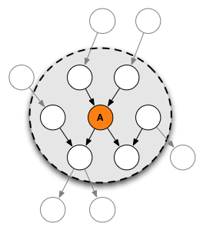
Markov Blanket
In Bayesian network, the Markov Blanket of Node A includes its parents, children and the other parents of all of its children.
Carries all information about A
All dependency relations of A
MB (A)
[Courtesy of Wikipedia.com]
Structure
Evidence
Belief Networks
Causality
Summary

Slide 20
Collision
Path P, Node c, Neighbor nodes a and b on P:
a → c ← b ➔ c is a collider
A collider is path specific (i.e. is defined relative to a path)
z is collider?




Structure
Evidence
Belief Networks
Causality
Summary

Slide 21
Independence using Collision
A non-collider z which is conditioned along the path between x and y → cannot induce dependence between x and y.
A path between x and y which contains a collider & collider is not in the conditioning set (and neither are any of its descendants) → this path does not make x and y dependent.
A path between x and y which contains no colliders and no conditioning variables → this path ‘d-connects’ x and y.
x and y are independent?
Graphically Conditionally Dependent




Structure
Evidence
Belief Networks
Causality
Summary

Slide 22
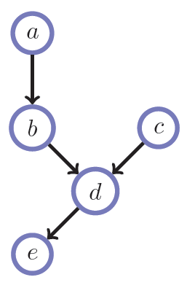
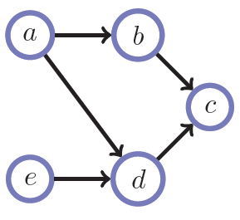
Example
a ╨ e | b ?
a ╨ e | c ?


Structure
Evidence
Belief Networks
Causality
Summary

Slide 23
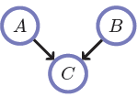
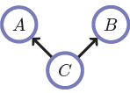
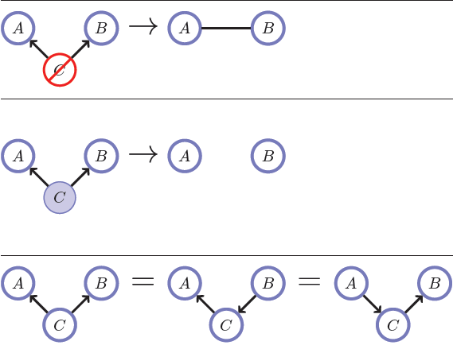
A ╨ B ?
p(A,B,C) = p(C|A,B)p(A)p(B)
p(A,B,C) = p(A|C)p(B|C)p(C)
Marginalization
Graphically Dependent
Conditioning
Independent
Structure
Evidence
Belief Networks
Causality
Summary

Slide 24
Example 1

A
C ╨ A ?
C ╨ A|B?
C ╨ D?
C ╨ D|A?
E ╨ C|D?
Any two variables are independent if they are not linked by just unknown variables.


B
D


C
E
Structure
Evidence
Belief Networks
Causality
Summary

Slide 25
Example 2

A ╨ E ?
A ╨ E|B?
A ╨ E|C?
A ╨ B?
A ╨ B|C?
Don’t forget the explain away effect!

A
B


C

D
E
Structure
Evidence
Belief Networks
Causality
Summary

Slide 26
In Other Words: In/Active Triplets
Active Triplets
Render variables dependent
Inactive Triplets
Render variables independent
: Known Evidence
Structure
Evidence
Belief Networks
Causality
Summary

Slide 27
Example 3
A
C
F
F ╨ A ?
F ╨ A|D?
F ╨ A|G?
F ╨ A|H?
Use shading the known technique.

B
E


H
D

G
Structure
Evidence
Belief Networks
Causality
Summary

Slide 28
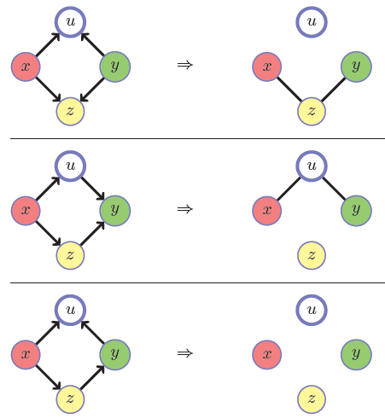
Blocked Path of Dependence (z is given)
If there is a collider not in the conditioning set (upper path) we cut the links to the collider variable. In this case the upper path between x and y is ‘blocked’.
If there is a non-collider which is in the conditioning set (bottom path), we cut the link between the neighbors of this non-collider which cannot induce dependence between x and y. The bottom path is ‘blocked’.
In this case, neither path contributes to dependence. Both paths are ‘blocked’.
Structure
Evidence
Belief Networks
Causality
Summary

Slide 29
D-Separation & D-connection
G is a DAG, X & Y & Z are disjoint sets in G
X and Y are d-connected by Z in G iff
There exist an undirected path U between some vertex in X and some vertex in Y such that for every collider C on U, either C or a descendent of C is in Z, and no non-collider on U is in Z.
X and Y are d-separated by Z in G iff they are not d-connected.
If all paths between X and Y are blocked then X and Y are d-separated by Z in G.
A path U is said to be blocked if there is a node w on U such that either
w is a collider and neither w nor any of its descendants is in Z, or
w is not a collider on U and w is in Z.
Structure
Evidence
Belief Networks
Causality
Summary

Slide 30
Bayes Ball Algorithm
Linear Time Complexity
Given X and Z
Determines the set of nodes, Y, such that X╨Y|Z.
Y is called the set of irrelevant nodes for X given Z.
Remember: X and Y are d-separated if there is no active path between them.
Structure
Evidence
Belief Networks
Causality
Summary

Slide 31
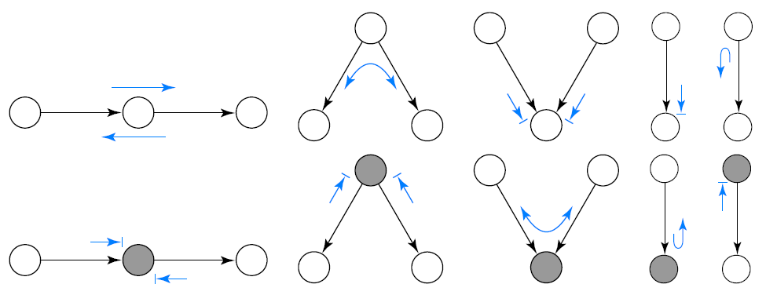
Bayes Ball Algorithm: The Ten Rules of Bayes Ball
An undirected path is active if a Bayes ball travelling along it never encounters the “stop”:
If there are no active paths from X to Y when {Z1, . . . ,Zk} are shaded, then X ╨ Y | {Z1, . . . ,Zk}.
Structure
Evidence
Belief Networks
Causality
Summary

Slide 32
Independence Using d-Separation
If the variable sets X and Y are d-separated by Z, they are independent conditional on Z in all probability distributions such a graph can represent.
If X and Y are d-connected by Z it doesn’t mean that X and Y are dependent in all distributions consist with the belief network structure.
Structure
Evidence
Belief Networks
Causality
Summary

Slide 33
Markov Equivalence
Two graphs are Markov equivalent if they both represent the same set of conditional independence statements.
This definition holds for both directed and undirected graphs.
Example
A→C←B ➔ CI statements: { A╨B|Ø }
A→C←B and A→C ➔ CI statements: { }
{ A╨B|Ø } ≠ { } ➔ these BNs are not Markov equivqlent.
Structure
Evidence
Belief Networks
Causality
Summary

Slide 34
Determining Markov Equivalence
Immorality in DAG: A configuration of three nodes, A, B, C such that C is a child of both A and B, with A and B not directly connected.
Skeleton of Graph: Result of removing the directions on the arrows.
Markov Equivalence: Two DAGs represent the same set of independence assumptions if and only if they have the same skeleton and the same set of immoralities.
Structure
Evidence
Belief Networks
Causality
Summary

Slide 35
Example: Markov Equivalent?
Structure
Evidence
Belief Networks
Causality
Summary

Slide 36
Causality
It doesn’t mean if:
the model of the data contains no explicit temporal information, so that formally only correlations or dependencies can be inferred
(i) p(a|b)p(b) or (ii) p(b|a)p(a). In (i) we might think that b ‘causes’ a, and in (ii) a ‘causes’ b. Clearly, this is not very meaningful since they both represent exactly the same distribution
Our intuitive understanding is usually framed in how one variable ‘influences’ another
Structure
Evidence
Belief Networks
Causality
Summary

Slide 37
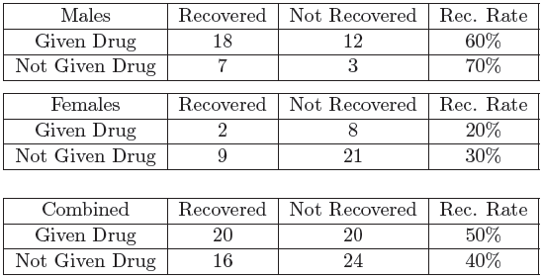
Simpson’s Paradox
Should we therefore recommend the drug or not?
?
Structure
Evidence
Belief Networks
Causality
Summary

Slide 38
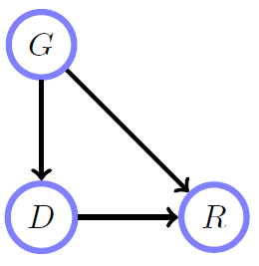
Resolution of the Simpson’s Paradox
Difference between ‘given that we see’ (observational evidence) and ‘given that we do’ (interventional evidence)
Normal p(G,D,R) = p(R|G,D)p(D|G)p(G)
Structure
Evidence
Belief Networks
Causality
Summary

Slide 39
Do-Calculus
Adjust the model to reflect any causal experimental conditions.
do operator: In setting any variable into a particular state → surgically remove all parental links of that variable. Pearl calls this the do operator, and contrasts an observational (‘see’) inference p(x|y) with a causal (‘make’ or ‘do’) inference p(x|do(y))
Inferring the effect of setting variables is equivalent to standard evidential inference in the post intervention distribution
The post intervention distribution corresponds to an experiment in which the causal variables are first set and non-causal variables are subsequently observed. → Any parental states pa (Xj) of Xj are set in their evidential states
For those variables for which we causally intervene and set in a particular state, the corresponding terms p(Xci|pa (Xci)) are removed from the original Belief Network.
For variables which are evidential but non-causal, the corresponding factors are not removed from the distribution.
Structure
Evidence
Belief Networks
Causality
Summary

Slide 40
Influence Diagram
Another way to represent intervention
To modify the basic BN by appending a parental decision variable F_{X} to any variable X on which an intervention can be made
If the decision variable F_{X} is set to the empty state, the variable X is determined by the standard observational term p(X|pa (X)). If the decision variable is set to a state of X, then the variable puts all its probability in that single state of X = x.
This has the effect of replacing the conditional probability term by a unit factor and any instances of X set to the variable in its interventional state.
Conditional independence statements can be derived using standard techniques for the augmented BN ☺
Structure
Evidence
Belief Networks
Causality
Summary

Slide 41
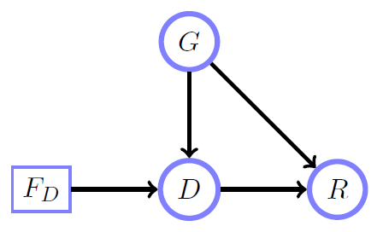
Simon’s Paradox Solution
Do-Calculus:
Interventional p(R||G,D) = p~ (R|G,D)
The term p(D|G) therefore needs to be replaced by a term that reflects the set-up of the experiment.
Influence Diagram
No decision variable is
required for G since G
has no parents
Structure
Evidence
Belief Networks
Causality
Summary

Slide 42
Summary
We can reason with certain or uncertain evidence using repeated application of Bayes' rule.
A belief network represents a factorization of a distribution into conditional probabilities of variables dependent on parental variables.
Belief networks correspond to directed acyclic graphs.
Variables are conditionally independent x╨y|z if p(x; y|z) = p(x|z)p(y|z); the absence of a link in a belief network corresponds to a conditional independence statement.
If in the graph representing the belief network, two variables are independent, then they are independent in any distribution consistent with the belief network structure.
Belief networks are natural for representing ‘causal’ influences.
Causal questions must be addressed by an appropriate causal model.
Structure
Evidence
Belief Networks
Causality
Summary

Slide 43
References
BRML – Chapter 3
Wikipedia
ai-class.com – Stanford Online Courseware
http://ai.stanford.edu/~paskin/gm-short-course/index.html
Structure
Evidence
Belief Networks
Causality
Summary

Slide 44
Questions?
Thank you for your time…

